Slide 1


Cover Page
Artificial Intelligent and
Machine Learning Based
Chatbot
Zawed Bin Tariq 2232811642
Nazmus Shakib 2312009042

Slide 2
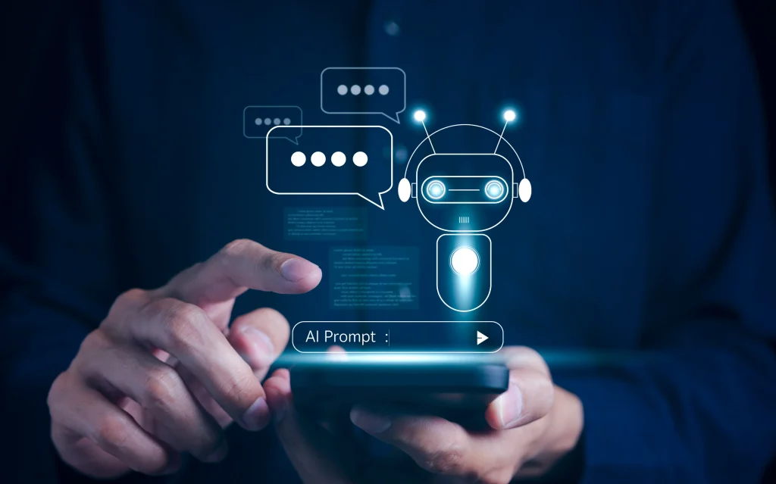
ROBOTS COLORING BOOK – PICTURE 1
Introduction
In the era of the Fourth Industrial Revolution, Artificial Intelligence (AI) and Machine Learning (ML) have become the driving forces behind transformative digital solutions.

Slide 3



Asha’s Dream: From Barrier to Bridge
In a quiet village of Bangladesh, Asha, a bright young girl, dreams of becoming a doctor. But in her rural community, access to accurate health information, educational resources, and modern tools is limited. Many times, she struggles to find answers—whether it’s understanding medicine instructions, translating information into her native Bangla, or calculating costs for her studies.

Slide 4
Here Comes our project envisioning an AI and Machine Learning–based multilingual chatbot that could be Asha’s companion in learning and problem-solving. Designed for the new century
Answer Questions & Chat Naturally
Multilingual Support
Mathematical Problem Solving
Text Translation & Summarization
Drug Information Retrieval
Rental Price Prediction

Slide 5
Who Can Use This Chatbot ?
Students – For translations, summaries, math solutions, and research help.
Healthcare Seekers – To get medicine details, side effects, and usage guidance.
Renters & Home Seekers – To estimate rental prices in Dhaka.
Non-English Speakers – Especially Bangla and Hindi users needing AI assistance.
Educators & Trainers – To provide multilingual support and quick information retrieval.
General Public – Anyone needing fast, reliable, AI-powered answers without advanced technical skills

Slide 6
Potential Uses of This Chatbot
Assisting students with translations, summaries, math problems, and research support.
Education
Providing medicine details, dosage guidelines, and health information in multiple
Acting as a multilingual support assistant for businesses.
Customer Service
Healthcare
Personal Productivity
Real Estate
Helping individuals with quick answers, calculations, and text processing.
Government & NGOs
Predicting rental prices for better decision-making in housing.
Offering information services to rural communities in Bangla and Hindi.

Slide 7
Gap Analysis
Aspect | Existing Solutions | Identified Gap | How This Project Fills the Gap
Language Support | Most chatbots focus on English, with limited multilingual capabilities. | Lack of support for South Asian languages such as Bangla and Hindi. | Provides multilingual interaction in Bangla, Hindi, and English.
Task Scope | Many are single-purpose (e.g., only Q&A, only translation, or only healthcare). | No integrated solution for multiple NLP and prediction tasks. | Combines Q&A, translation, summarization, math solving, rental prediction, and drug info retrieval in one platform.
Accessibility | Requires high-end systems, internet connectivity, or cloud resources. | Rural and low-resource users can’t easily access advanced chatbots. | Runs locally with lightweight deployment, minimal hardware needs.
Real-World Integration | Some academic prototypes lack practical application scenarios. | Missing features for real-life use in education, healthcare, and housing. | Offers real-world utility with targeted modules for these sectors.
User Training | Many chatbots are static and can’t learn from user interactions. | Lack of adaptability to user-specific needs. | Designed for user-trainable architecture for future adaptability.

Slide 8
SWOT Analysis
Limited training data for medicine and rental modules.
Spelling-sensitive input (especially for medicine search).
No mobile or voice interface in current version.
Slight latency in Bangla model inference.
Multilingual support (Bangla, Hindi, English) for wider accessibility.
Multi-task functionality (Q&A, translation, summarization, math solving, rental prediction, drug info).
Lightweight, runs locally without expensive hardware.
Modular design for easy upgrades and new features
Strengths
Threats
Opportunities
Weaknesses
Rapidly evolving AI competition from big tech companies.
Data privacy and ethical AI concerns.
Dependency on third-party APIs for some features.
Possible misuse if deployed without proper moderation.
Can expand to more languages and sectors (tourism, agriculture, e-commerce).
Collaboration with NGOs, healthcare providers, and education platforms.
Real-time learning and personalization with user feedback.
Integration into mobile apps for rural accessibility.

Slide 9
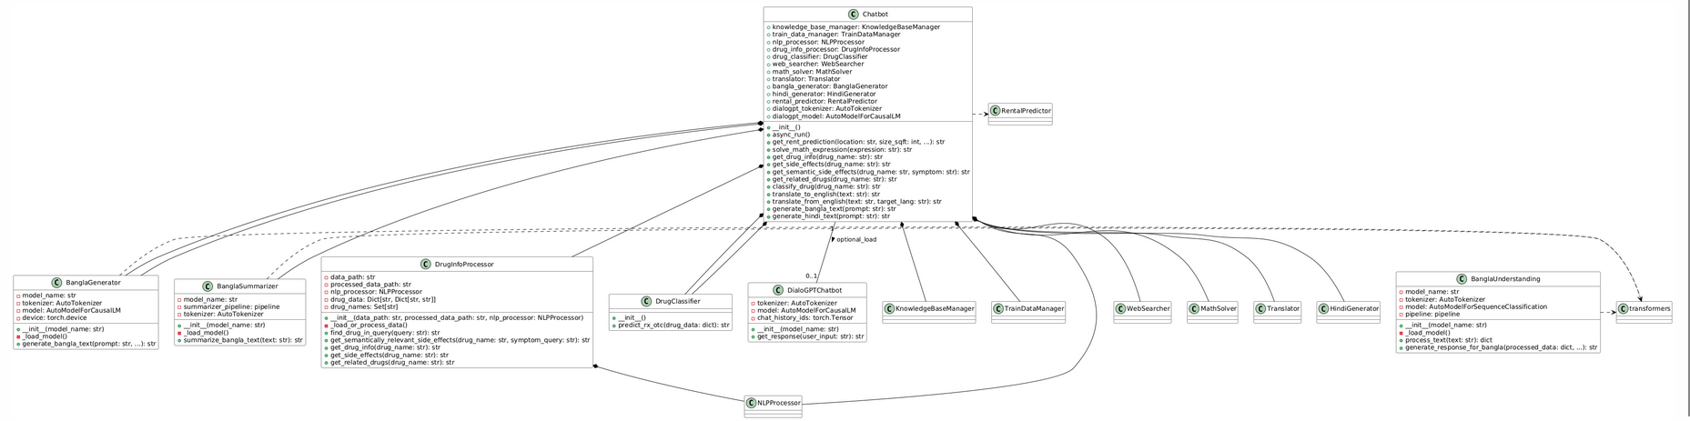
UML Diagram

Slide 10
Verdict
Reported As Inspiring By Iffat Iqbal iffat.Iqbal@iub.edu.bd
Reported: Excellent Work. Reviewed Highly positive of Medicines reviews integration
By Taif Sondhi
Taif.sondhi@northsouth.edu
Can you Work on Integration with Databases and Websites
By
Nusrat Jahan
Nice work. Keep it Up
By Jayanta Dey jayanta.dey@northsouth.edu

Slide 11
Conclusion
The project is a versatile and comprehensive chatbot system designed to handle a wide range of user queries. Its core strength lies in its modular and multi-functional architecture, integrating several specialized components to perform distinct tasks.
In conclusion, this project is a robust foundation for a powerful AI assistant. Its ability to process and respond to complex queries across multiple domains, combined with its use of state-of-the-art AI models, positions it as a sophisticated and highly extensible platform for future development.

Slide 12

Thankfully
We are deeply grateful to our teacher and project supervisor, Dr. Mohammad Shifat-E-Rabbi, for his expert guidance, patience, and invaluable advice throughout this journey.
We would like to extend our heartfelt gratitude to our classmates, whose feedback and encouragement inspired us to refine our ideas and push the project forward. Our sincere thanks to our friends, for their constant motivation, late-night brainstorming sessions, and willingness to test our chatbot in its early stages.
Finally, we thank everyone who supported us—directly or indirectly—through their time, ideas, and encouragement, making this project a reality.

Slide 13


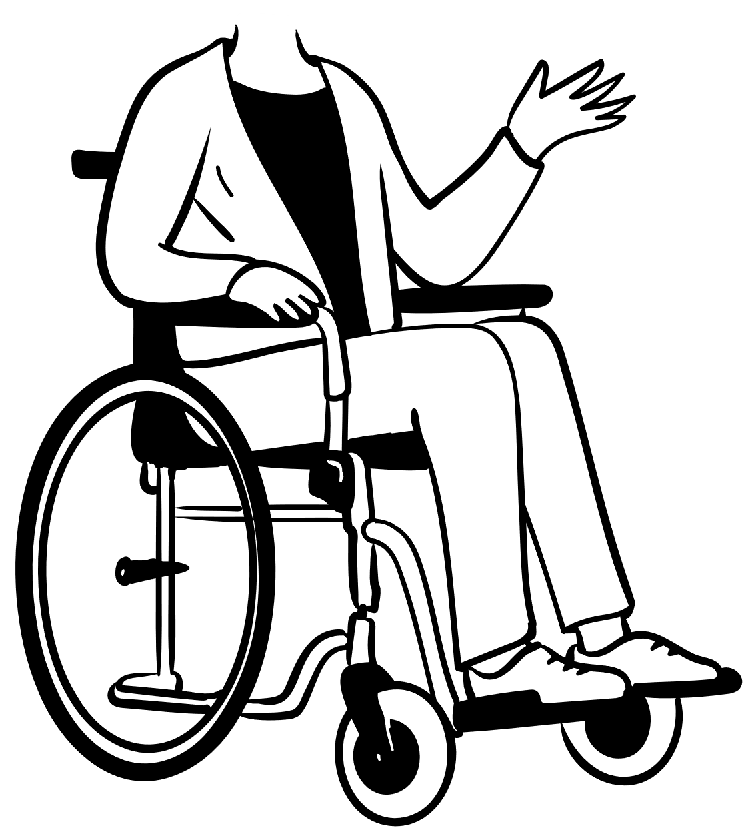
Any Question ?

